Slide 1

WIPRO NGA Program – Datacenter Batch5
Capstone Project Presentation – 06 April 2024
Project Title Here – Installation of centOS-7 & managing user & group & configure Filepermission
Presented by - Kishor Chandra Sahoo
www.rpsconsulting.in

Slide 2
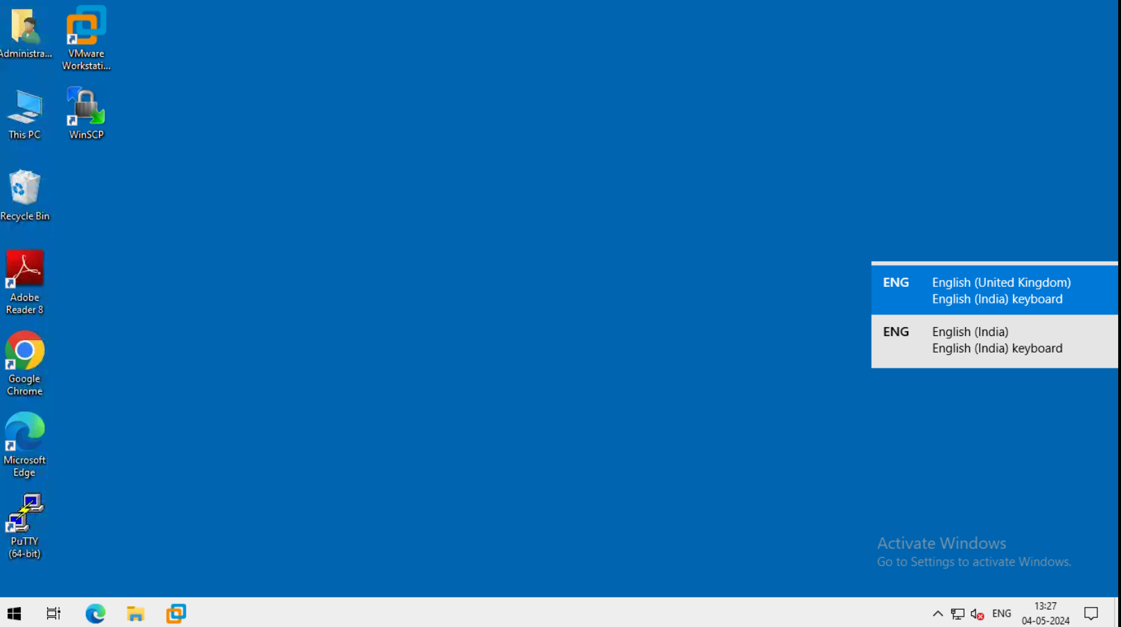
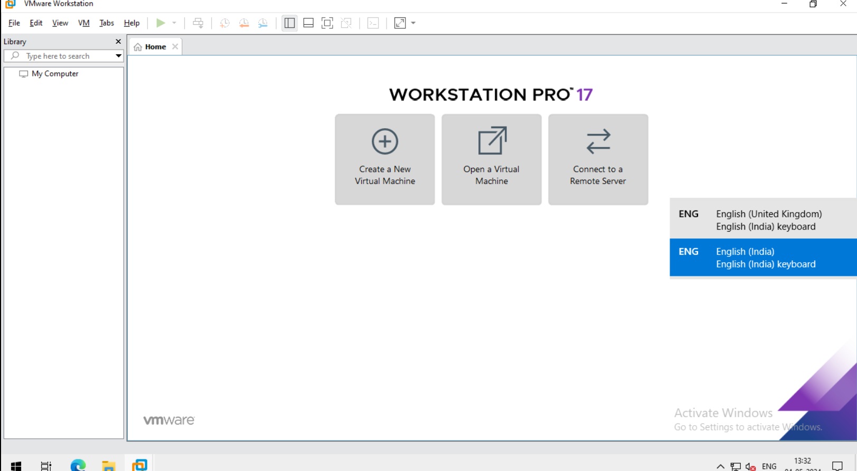

Slide Title
Here is the first page of cloud Environment.
Here is the first step of installation and open view of vmware.

Slide 3
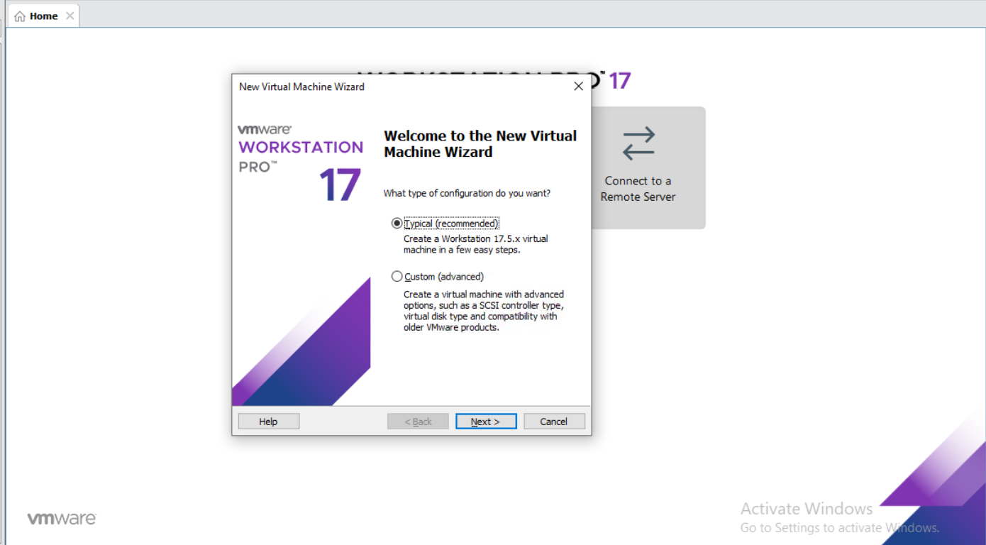
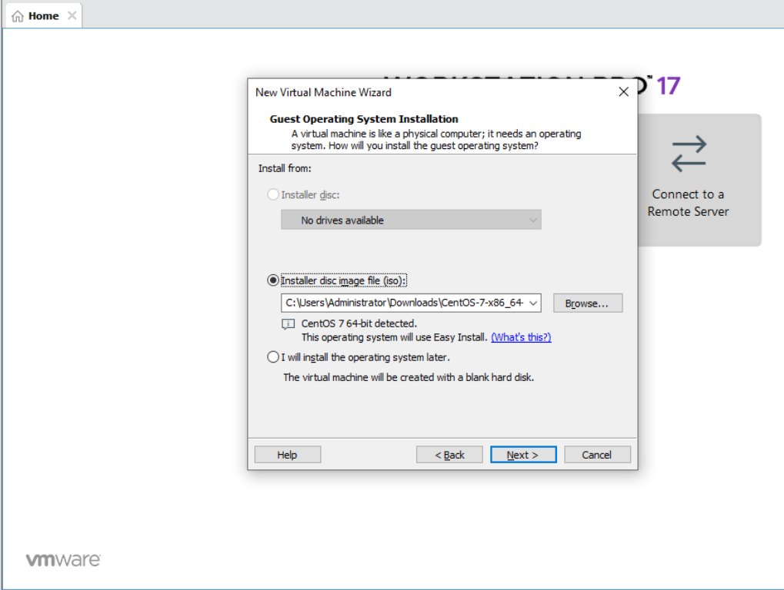
After clicking Create a new virtual machine ,Then we have this interface.
In this step choose typical.
After Clicking Typical this is the next step , In here we browse CentOS7 -7 Click Next.

Slide 4
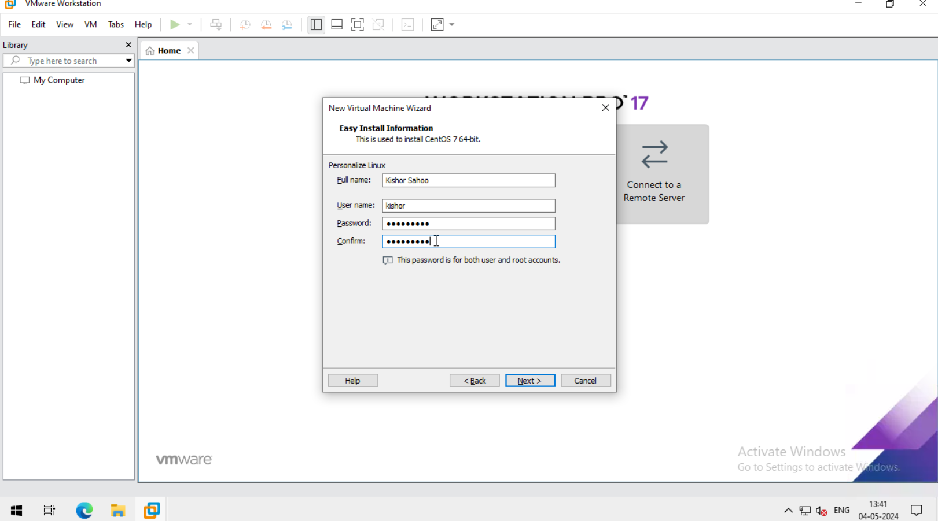
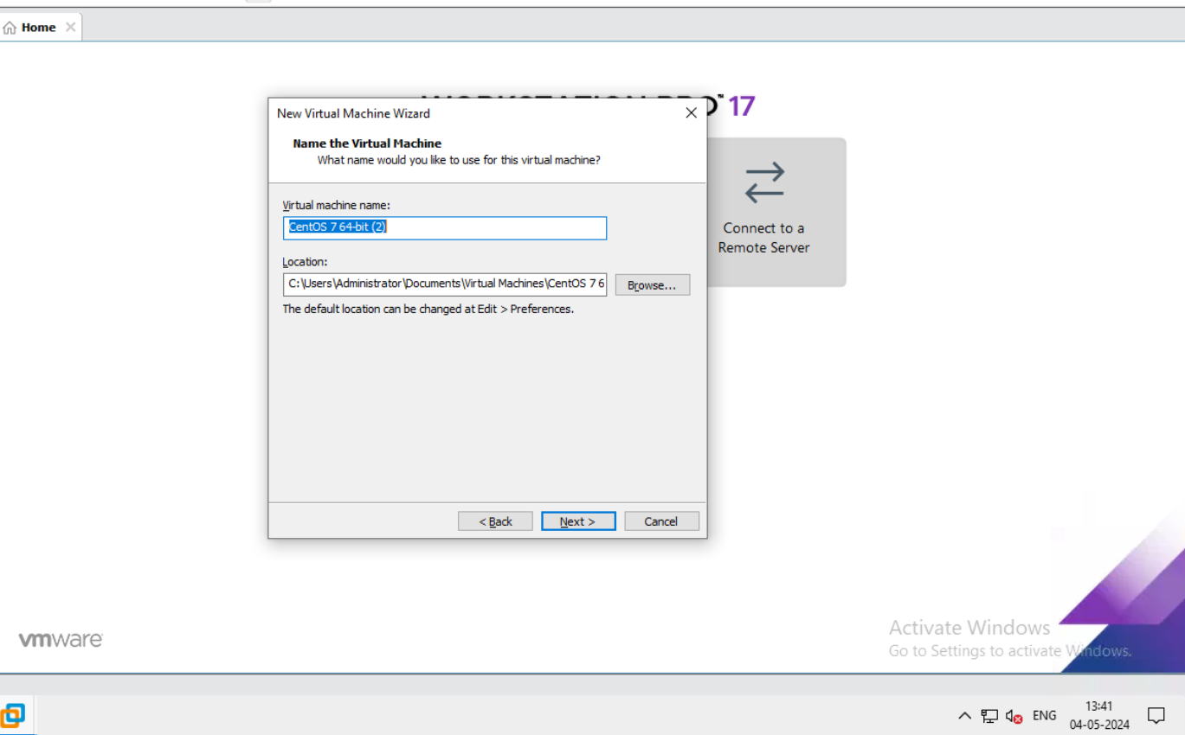
After browse next step is assign full name, user name & password.
Then click next.
After that give the name of the virtual machine.

Slide 5
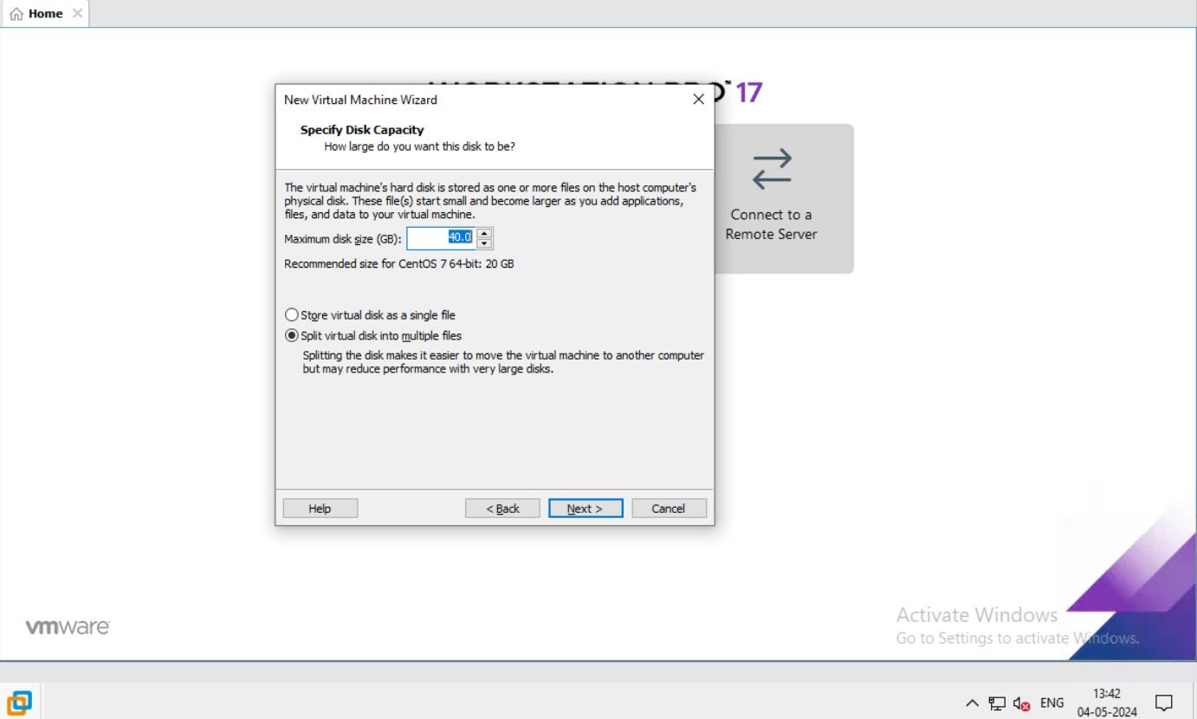
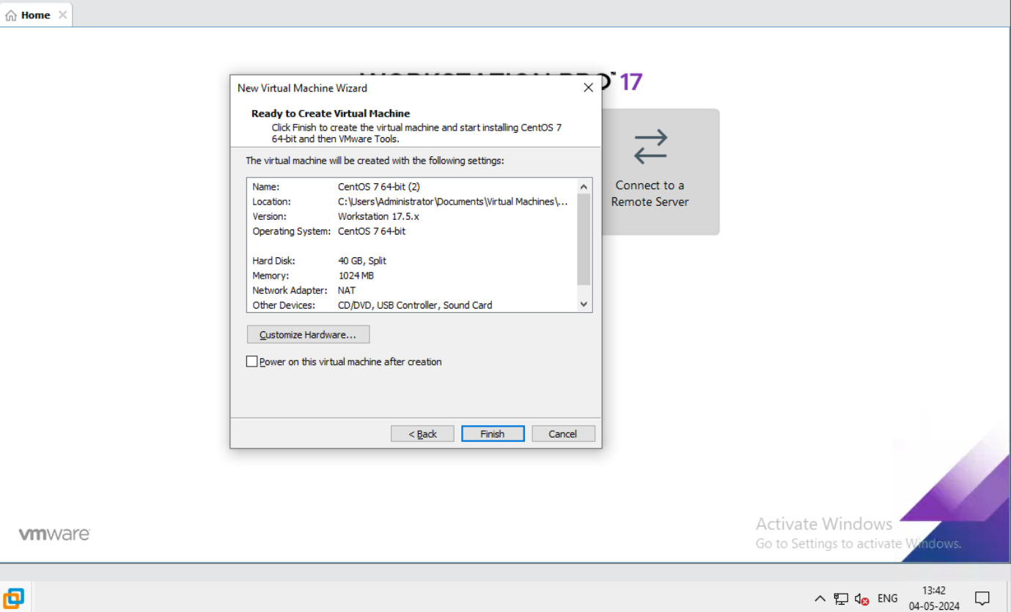
After that here we give Disk size of the machine.
Click Next.
In this step ,our CentOS-7 Virtual machine ready to create.
Then click Next.

Slide 6
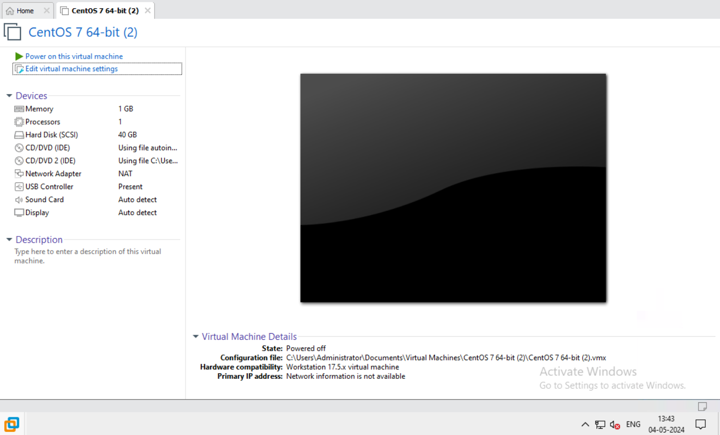
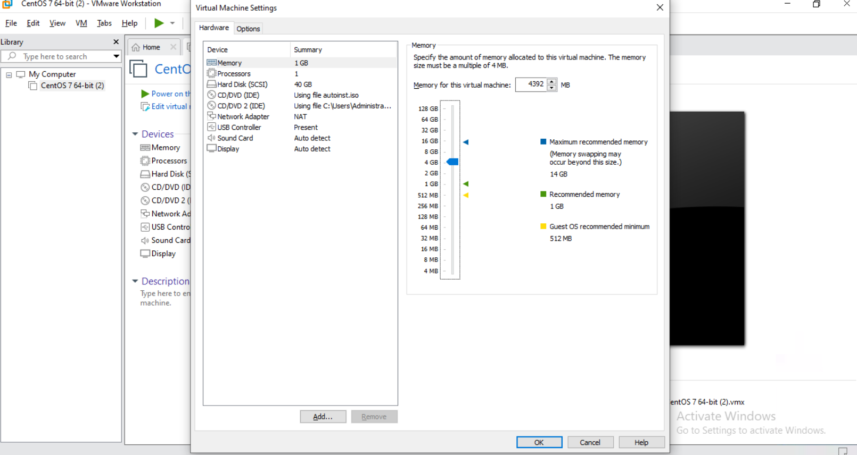
Here is the first step after finished or first look of centOS-7.
After that edit the virtual machine setting.
Here is the first look.

Slide 7
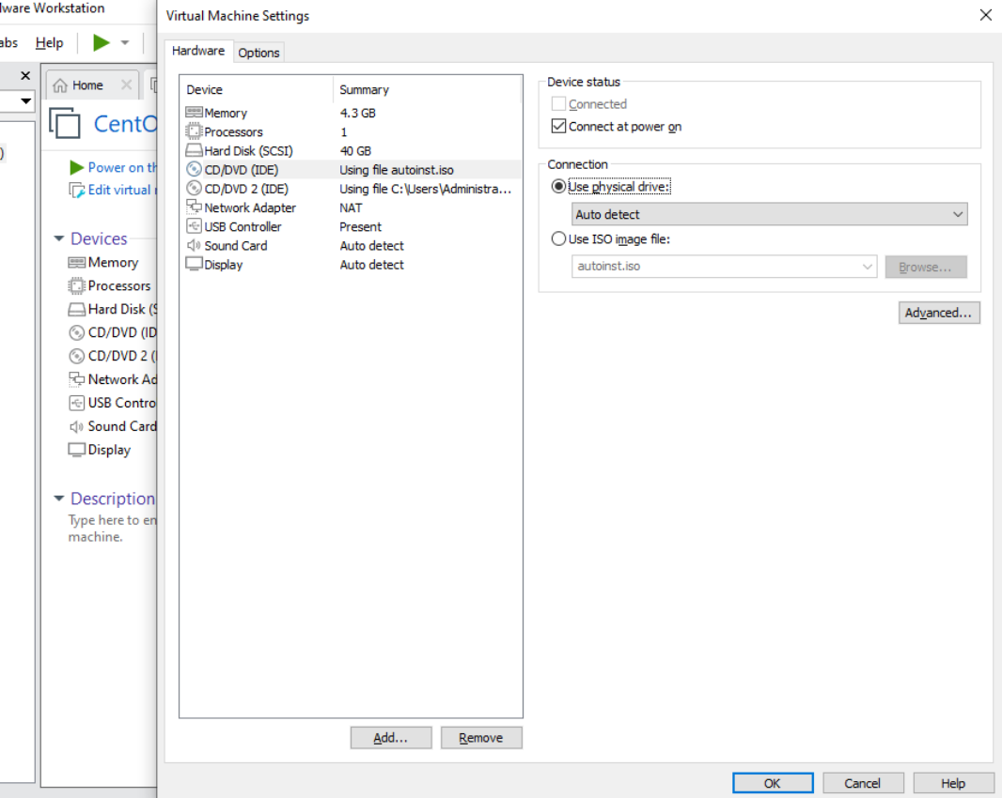
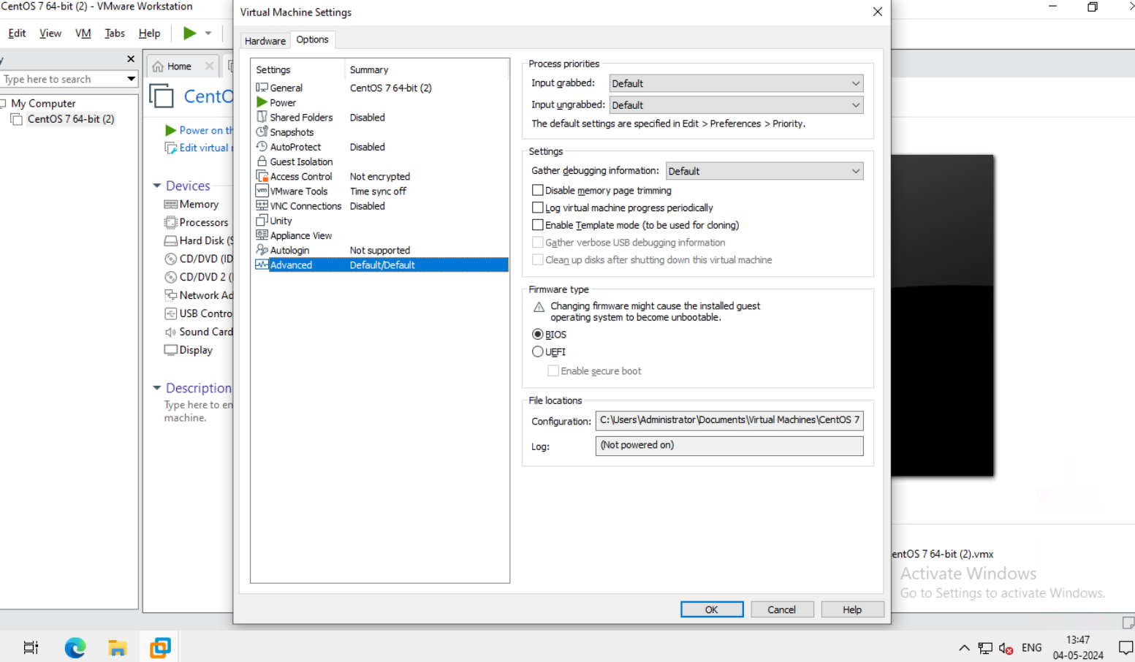
Now go to the CD/DVD Choose physical drive.
Click ok.
Now go to the advance choose BIOS.
Click ok.

Slide 8
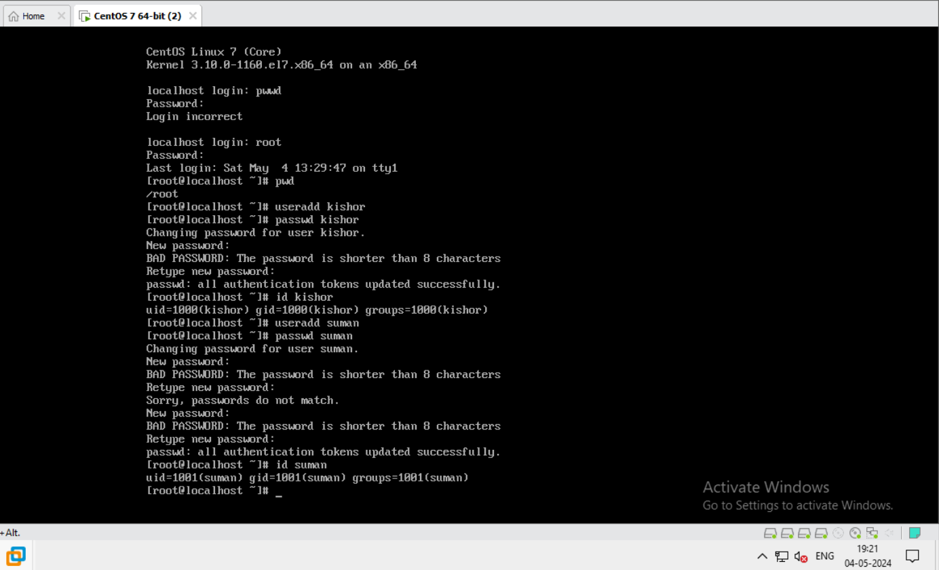
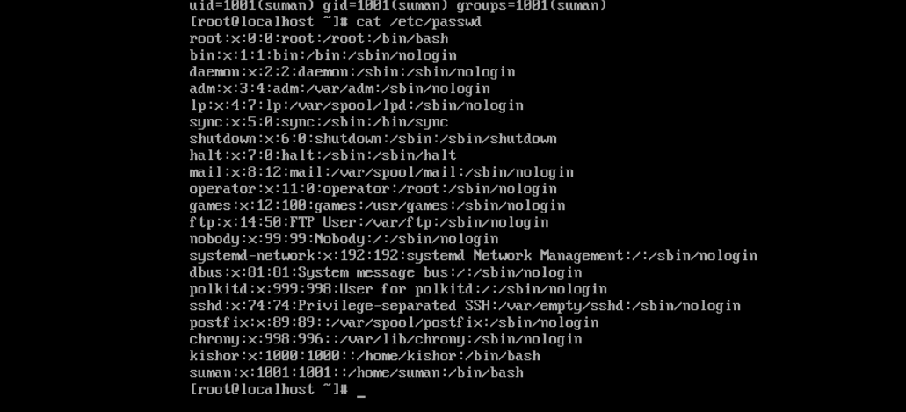
First login with root.
Then Give password.
Create user and group by the help of useradd and groupadd command.
In 2nd slide verify user and group.

Slide 9
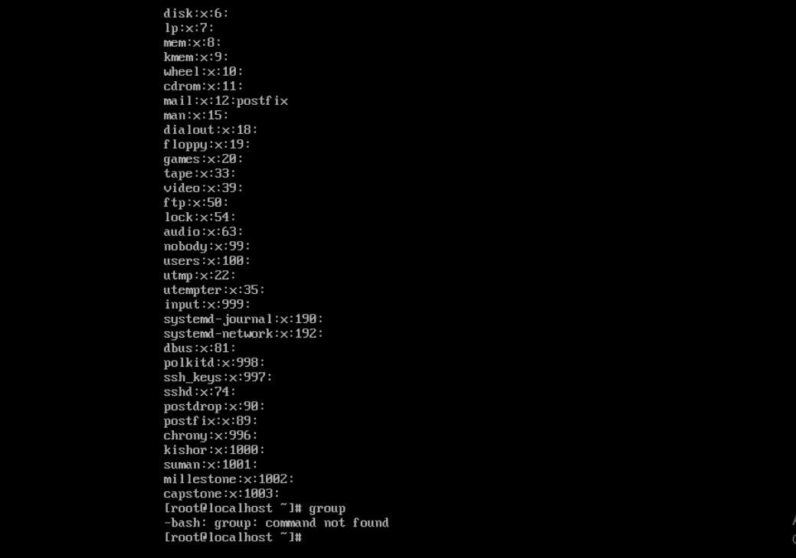
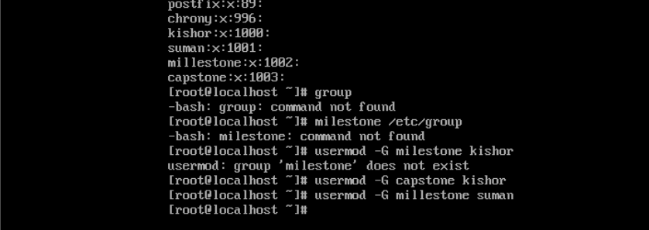
Here verify group that is milestone and capstone.
Assign user to group.
Here user name suman & Kishor.
Group Name capstone & milestone.

Slide 10
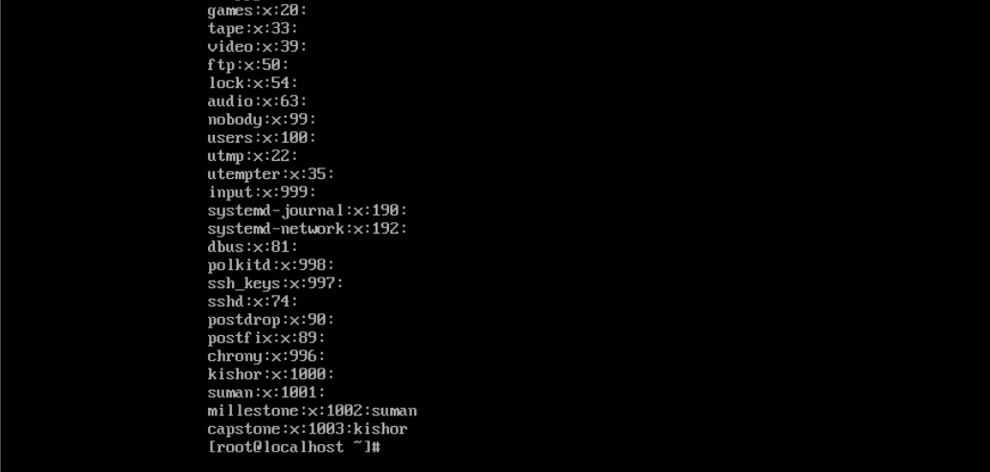
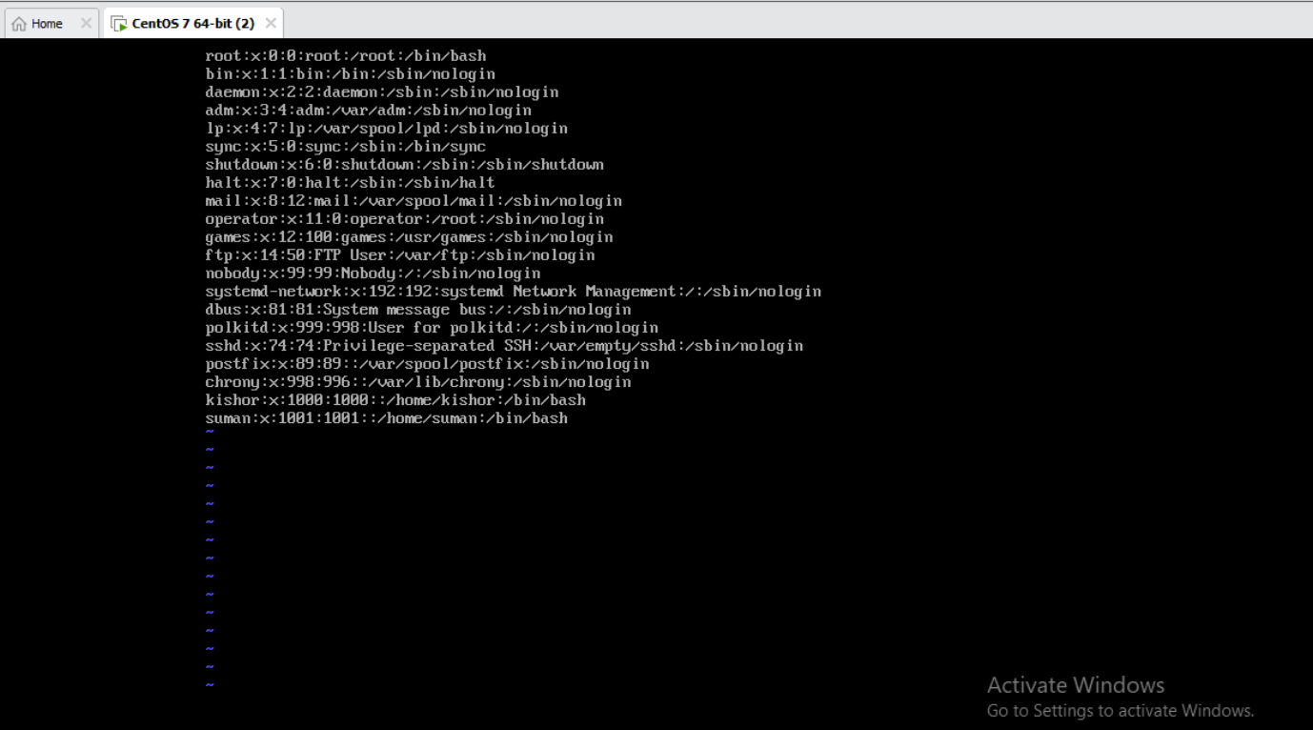
Here verifying assign user to group .

Slide 11
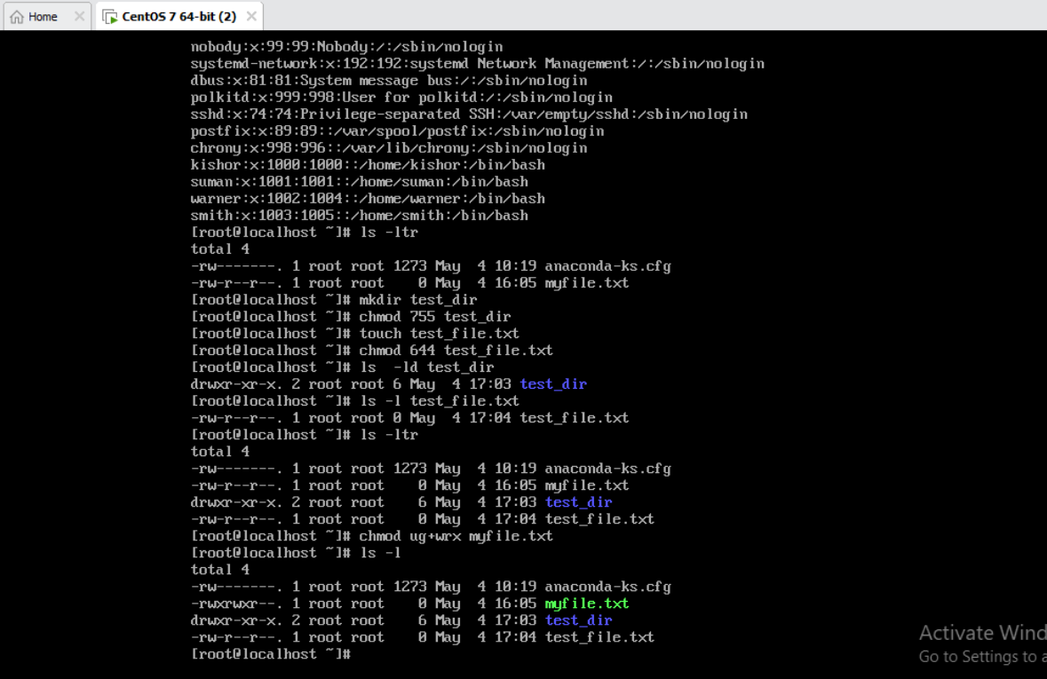
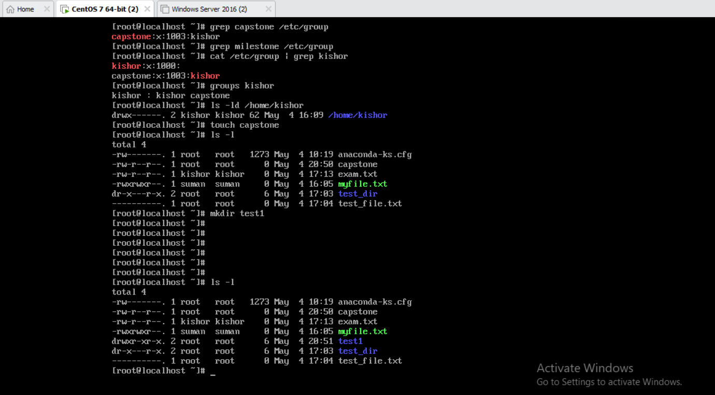
Here use command to list file in the directory.
Then create a directory.
And give the permission using chmod.
Then again run ls –ltr .
Using grep serch the string.
Then display the content of group.
Then create empty file using touch.
Then create a directory.

Slide 12
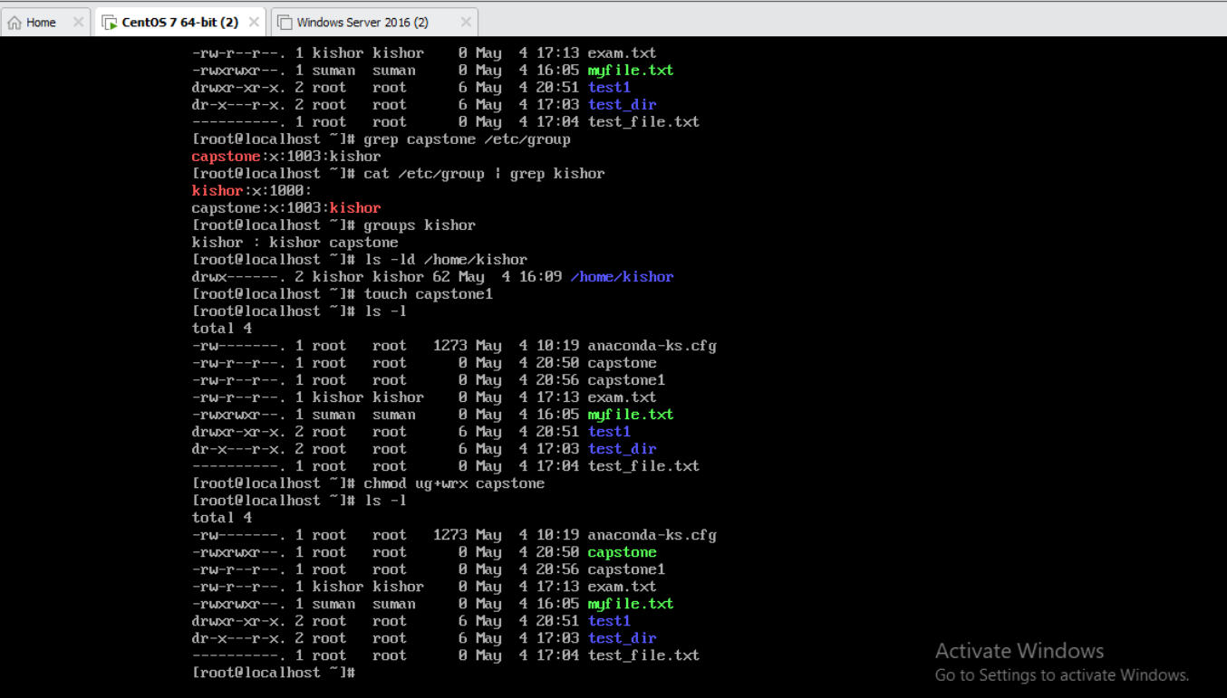
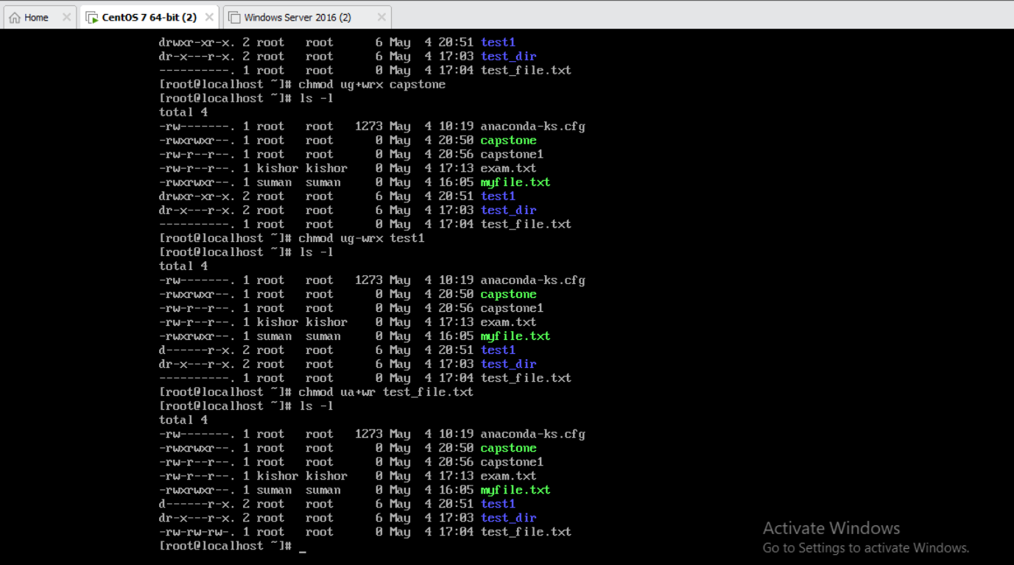
Then using cat command display the content.
Then using ls –l list file and directory in long format.
Then using chmod we give permissions to empty file and other .
Here uga used & u for user , g for group , a for all and also wrx means w for write , r for read and x for execute.
By the help of above we give the permissions.

Slide 13
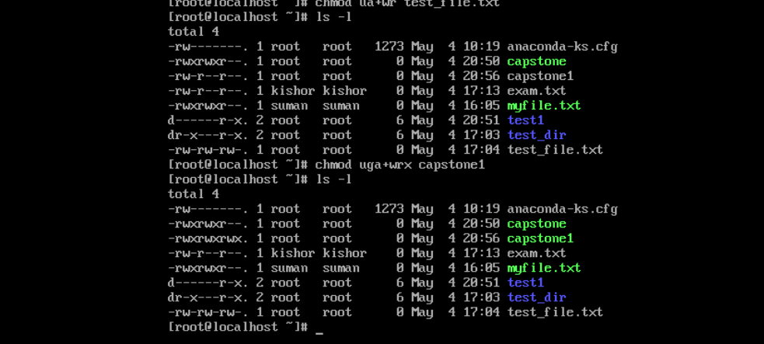
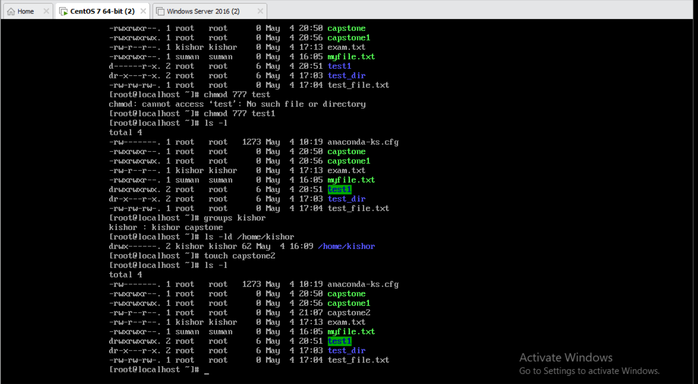
Here also give file permission to file and other .
Use chmod 777 for change the permission of file.
Then give list information about two items “user” & “/home/Kishor”.
Then list file and directory in long format.

Slide 14
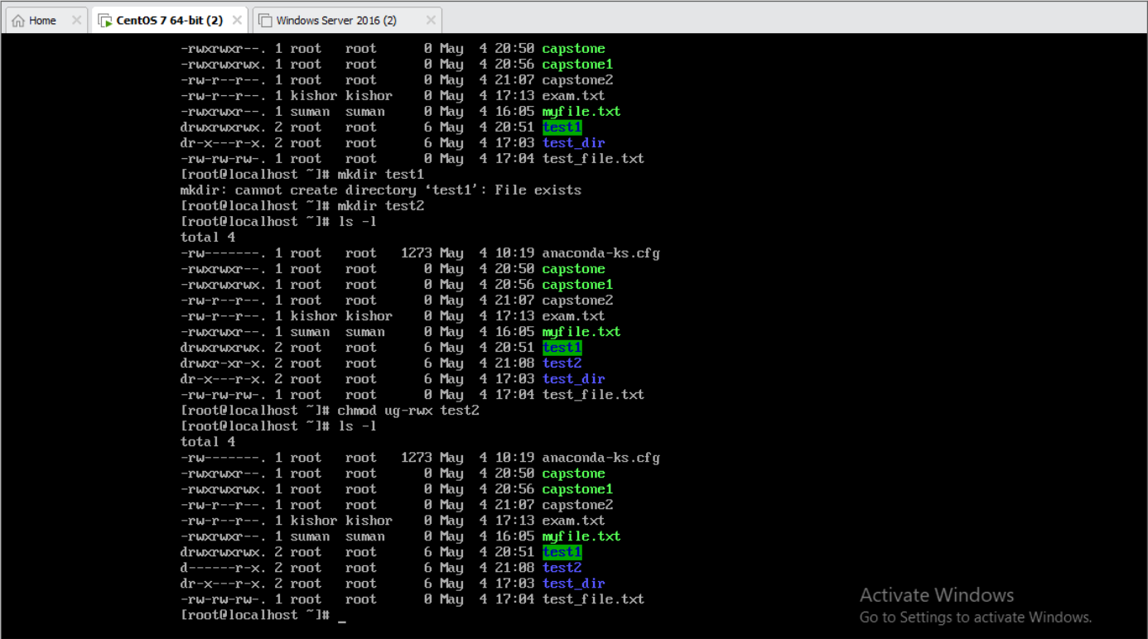
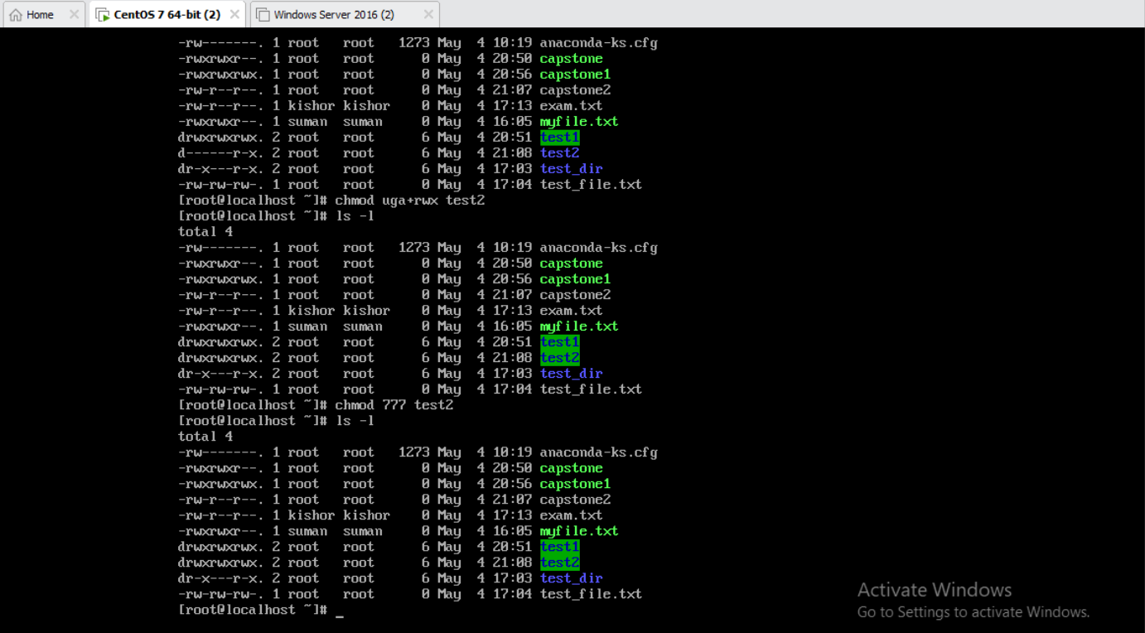
Here explain more permission and long list of file.
That’s all.

Slide 15
Thank You
Kishor Chandra Sahoo

